Slide 1
Resistance and Capacitance
Session 4-5
SCIE6063
COMPUTATIONAL PHYSICS
June 2024

Slide 2
Resistance

Slide 3
These slides have been adapted from
Halliday D.; Resnick R. and Walker J. (2018). Fundamentals Of Physics ,Extended,
11th , John Wiley & SONS Inc, New York, ISBN: 9781119306856
Chapter 25

Slide 4


Resistance and Resistivity
We determine the resistance between any two points of a conductor by applying a potential difference V between those points and measuring the current i that results.
The resistance R is then
The SI unit for resistance is the ohm (symbol Ω).
1 ohm= 1 Ω = 1 volt per ampere = 1 V/A
In a circuit diagram, we represent a resistor and a
resistance with the symbol

Slide 5
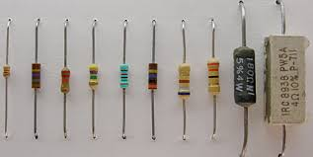
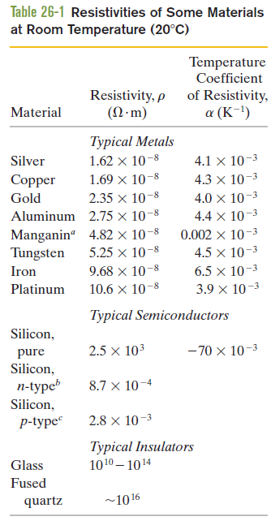
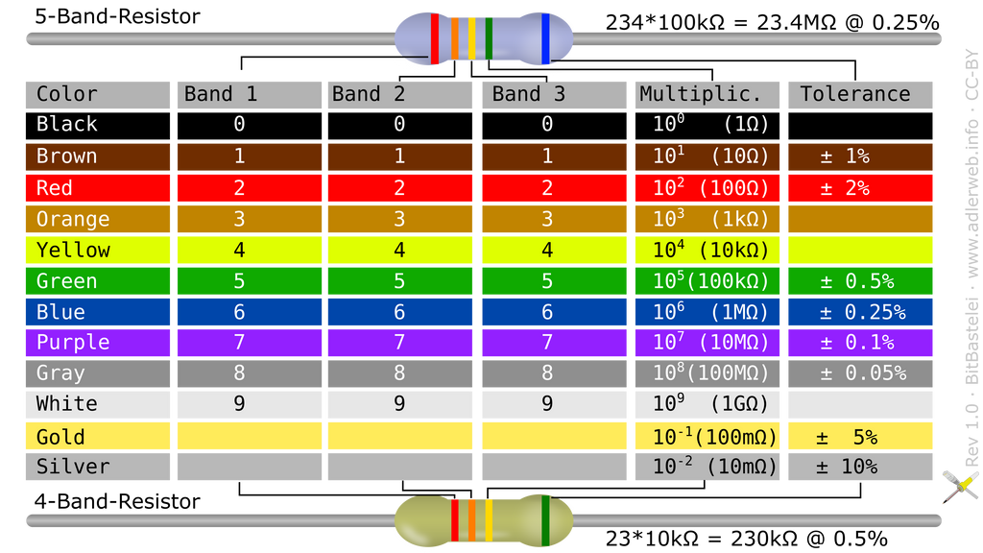
Resistors
https://www.electronicsforu.com/

Slide 6




Resistance and Resistivity (cont.)
The resistivity, ρ, of a resistor is defined as:
The SI unit for ρ is Ω.m.
The conductivity σ of a material is the reciprocal of its resistivity:

Slide 7



Resistance and Resistivity (cont.)
L
i
i
A
V
If the streamlines representing the current density are uniform throughout the wire, the electric field, E, and the current density, J, will be constant for all points within the wire.
Fig.5. A potential difference V is applied between the ends of a wire of length L and cross section A, establishing a current i.

Slide 8
Resistance and Resistivity (cont.)
Example, A material has resistivity, a block of the material has a resistance.:
A rectangular block of iron has dimensions 1,2cmx1,2cmx15cm. A potential difference is to be applied to the block between parallel sides and in such a way that those sides are equipotential surfaces. What is the resistance of the block if the two parallel sides:
(1) the square ends (with dimensions 1,2x1,2 cm) and (2) two rectangular sides (with dimensions 1,2x15 cm)

Slide 9

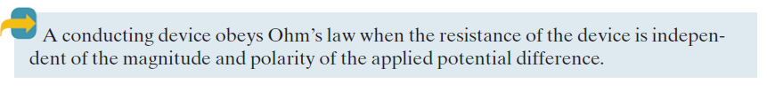
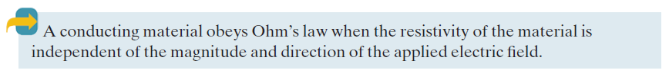
4. Ohm’s Law

Slide 10
The battery at the left supplies energy to the conduction electrons that form the current
i
i i
?
i
Figure 6. A battery B sets up a current I in a circuit containing an unspecified conducting device
5. Power in Electric Circuits
In the figure, there is an external conducting path between the two terminals of the battery. A steady current i is produced in the circuit, directed from terminal a to terminal b. The amount of charge dq that moves between those terminals in time interval dt is equal to idt.
This charge dq moves through a decrease in potential of magnitude V, and thus its electric potential energy decreases in magnitude by the amount
dU = dq V = I dt V
a
b

Slide 11




Power in Electric Circuits (cont.)
The power P associated with that transfer is the rate of transfer dU/dt, given by
The unit of power is the volt-ampere (V A).

Slide 12
Power in Electric Circuits (cont.)
Example, Rate of Energy Dissipation in a Wire Carrying Current:
You are given a length of uniform heating wire made of a nickel-chromium-iron alloy called Nichrome: it has a resistance R of 72 Ω. At what rate is energy dissipated in each of the following situations?
A potential difference of 120 V is applied across the full length of the wire.
The wire is cut in half, and a potential difference of 120 V is applied across the length
Source: Halliday, et All 2010

Slide 13
Capacitance

Slide 14
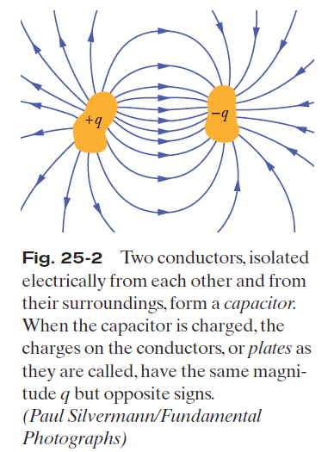

Slide 15
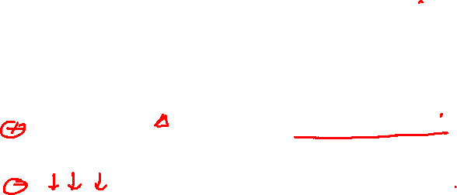
Capacitance(cont.)
Electric field lines
+q
-q
A
A
d
Top side of bottom plate has charge -q
(b)
Bottom side of top plate has charge +q

Slide 16
Capacitance(cont.)
When a capacitor is charged, its plates have charges of equal magnitudes but opposite signs: q+ and q-. However, we refer to the charge of a capacitor as being q, the absolute value of these charges on the plates.
q= CV
The charge q and the potential difference V for a capacitor are proportional to each other:
The proportionality constant C is called the capacitance of the capacitor. Its value depends only on the geometry of the plates and not on their charge or potential difference.
The SI unit is called the farad (F):
1 farad (1 F)= 1 coulomb per volt =1 C/V.

Slide 17
2. Calculating the Capacitance
Parallel-Plate Capacitor
We use Gauss’ law to relate q and E. Then we integrate to get the potential difference.
+q
d
Gaussian
surface
A
-q
Path of
integration
Fig.2. A charged parallel-plate capacitor. A Gaussian surface encloses the charge on the positive plate. The integration of equation of the potential difference is taken along a path extending directly from the negative plate to the positive plate.

Slide 18


Calculating the Capacitance (cont.)

Slide 19




Calculating the Capacitance (cont.)

Slide 20
Calculating the Capacitance (cont.)
Total charge +q
Cylindrical Capacitor
As a Gaussian surface, we choose a cylinder of length L and radius r, closed by end caps and placed as is shown.
It is coaxial with the cylinders and encloses the central cylinder and thus also the charge q on that cylinder.
q = ε₀ EA = ε₀ E(2πrL)
b
a
r
Path of integration
Gaussian surface
Fig.3. A cross section of a long cylindrical capacitor, showing a cylindrical Gaussian surface of radius r and the radial path of integration

Slide 21


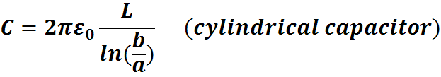
Calculating the Capacitance (cont.)

Slide 22



Calculating the Capacitance (cont.)
Total charge +q
Total charge –q
Spherical Capacitor
a
r
b
Gaussian surface
Path of integration
Fig.4. A cross section of a
Spherical Capacitor

Slide 23


Calculating the Capacitance (cont.)
Isolated Sphere:
We can assign a capacitance to a single isolated spherical conductor of radius R by assuming that the “missing plate” is a conducting sphere of infinite radius.
The field lines that leave the surface of a positively charged isolated conductor must end somewhere; the walls of the room in which the conductor is housed can serve effectively as our sphere of infinite radius.
To find the capacitance of the conductor, we first rewrite the capacitance as:
Now letting b→∞, and substituting R for a,
(isolated sphere)

Slide 24
terminal
3. Capacitors in Parallel
+q₃
V
-q₃ C₃
+q₂
V
-q₂ C₂
+q₁
V
-q₁ C₁
+
-
When a potential difference V is applied across several capacitors connected in parallel, that potential difference V is applied across each capacitor. The total charge q stored on the capacitors is the sum of the charges stored on all the capacitors.
Capacitors connected in parallel can be replaced with an equivalent capacitor that has the same total charge q and the same potential difference V as the actual capacitors.
B
terminal
(a)
+q
-q C_{eq}
B
+
-
V
(b)
Fig.5. (a) Three capacitors connected in parallel to battery B.
(b) The equivalent capacitor, with capacitance C_{eq} replaces the parallel combination.

Slide 25
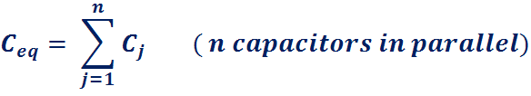

Slide 26
4. Capacitors in Series
terminal
When a potential difference V is applied across several capacitors connected in series, the capacitors have identical charge q.
The sum of the potential differences across all the capacitors is equal to the applied potential difference V.
+q₁
V
-q₁ C₁
V
+q
-q C_{eq}
+
-
B
+q₂
-q₂ C₂
V
+
-
B
V
Series capacitors and their equivalent have the same q.
+q₃
V
-q₃ C₃
terminal
Fig. 6. (a) Three capacitors connected in series to battery B.
The battery maintains potential difference V between the top and bottom plates of the series combination.
(b) The equivalent capacitor with capacitance C_{eq} replaces the series combination

Slide 27


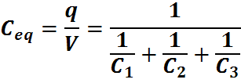

Capacitors in Series (cont.)

Slide 28

Capacitors in Series (cont.)

Slide 29


5. Energy Stored in an Electric Field
The potential energy of a charged capacitor may be viewed as being stored in the electrin field between its plates.
Suppose that, at a given instant, a charge q’ has been transferred from one plate of a capacitor to the other. The potential difference V’ between the plates at that instant will be q’/C. If an extra increment of charge dq’ is then transferred, the increment of work required will be,
The work required to bring the total capacitor charge up to a final value q is

Slide 30

Energy Stored in
an Electric Field (cont.)

Slide 31



6. Energy Density
In a parallel-plate capacitor, neglecting fringing, the electric field has the same value at all points between the plates. Thus, the energy density u that is, the potential energy per unit volume between the plates should also be uniform.
We can find u by dividing the total potential energy by the volume Ad of the space between the plates.
But since(C =ε ₀A/d), this result becomes
However, (E=-ΔV/Δs), V/d equals the electric field magnitude E. Therefore.

Slide 32
7. Capacitor with a Dielectric
In a region completely filled by a dielectric material of dielectric constant κ, all electrostatic equations containing the permittivity constant ε₀ are to be modified by replacing ε₀ with κε₀.
A dielectric, is an insulating material such as mineral oil or plastic, and is characterized by a numerical factor κ, called the dielectric constant of the material.
Some dielectrics, such as strontium titanate, can increase the capacitance by more than two orders of magnitude.
The introduction of a dielectric also limits the potential difference that can be applied between the plates to a certain value Vmax, called the breakdown potential. Every dielectric material has a characteristic dielectric strength, which is the maximum value of the electric field that it can tolerate without breakdown.

Slide 33
Example, Work and Energy when a Dielectric is inserted inside a Capacitor:
A parallel-plate capacitor whose capacitance C is 13,5 pF is charged by a battery to a potential difference V=12,5 V between its plates. The charging battery is now disconnected, and a porcelain slab (κ=6,50) is slipped between the plates.
a) What is the potential energy of the capacitor before the slab is inserted?
b) What is the potential energy of the capacitor of capacitor-slab device after the slab is inserted?
Source: Halliday, et All 2010

